Slide 1
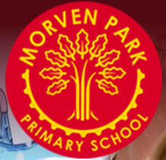
Welcome to
Foundation Stage
2

Slide 2
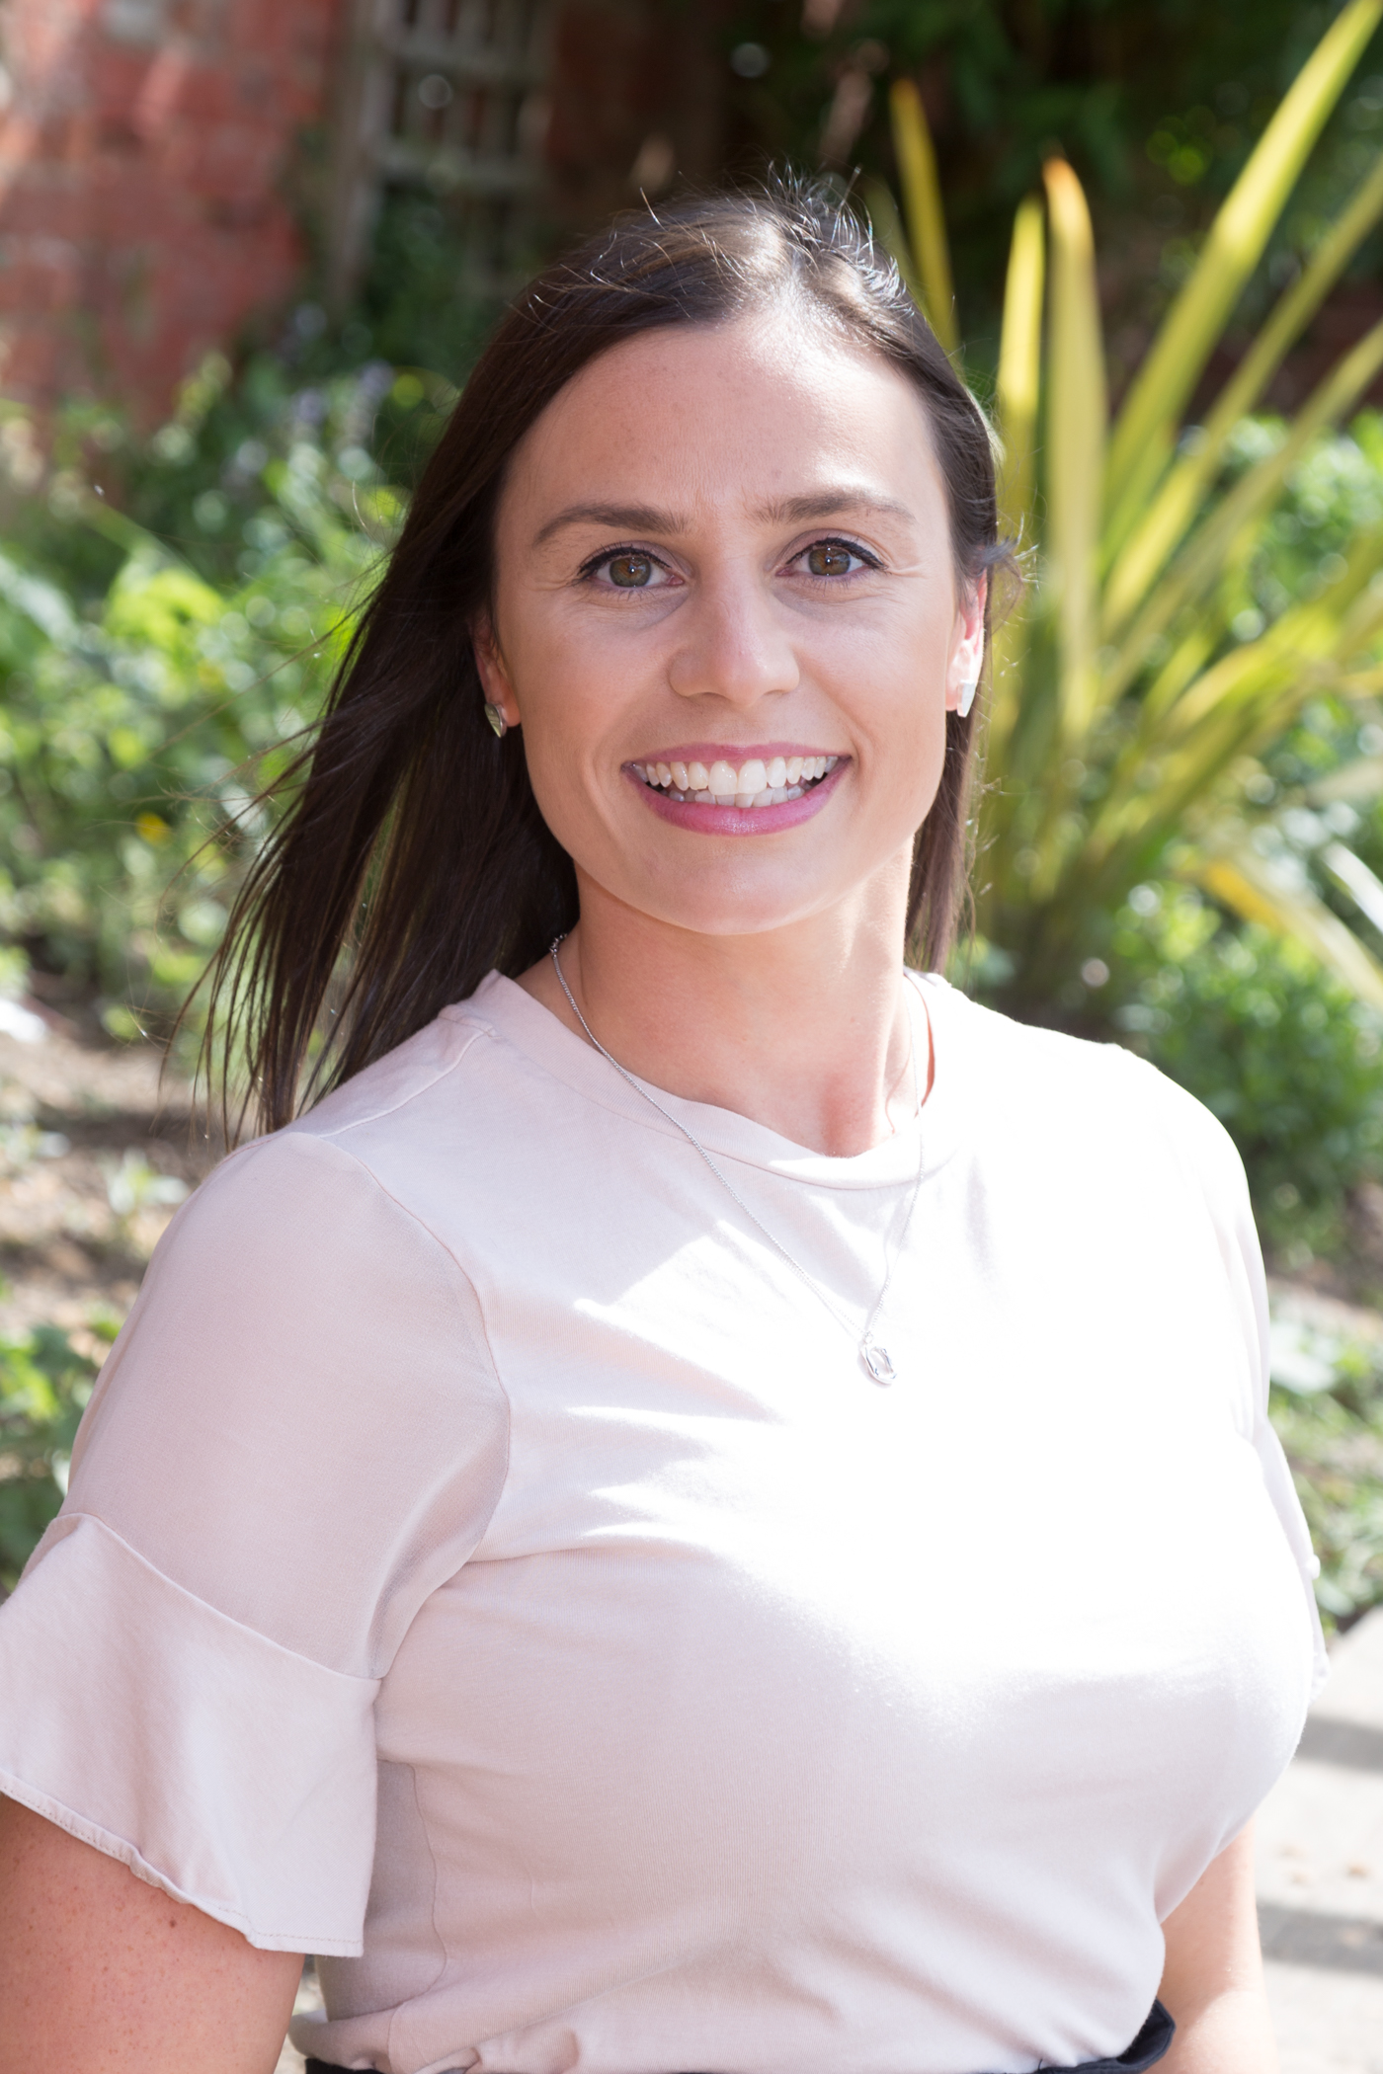
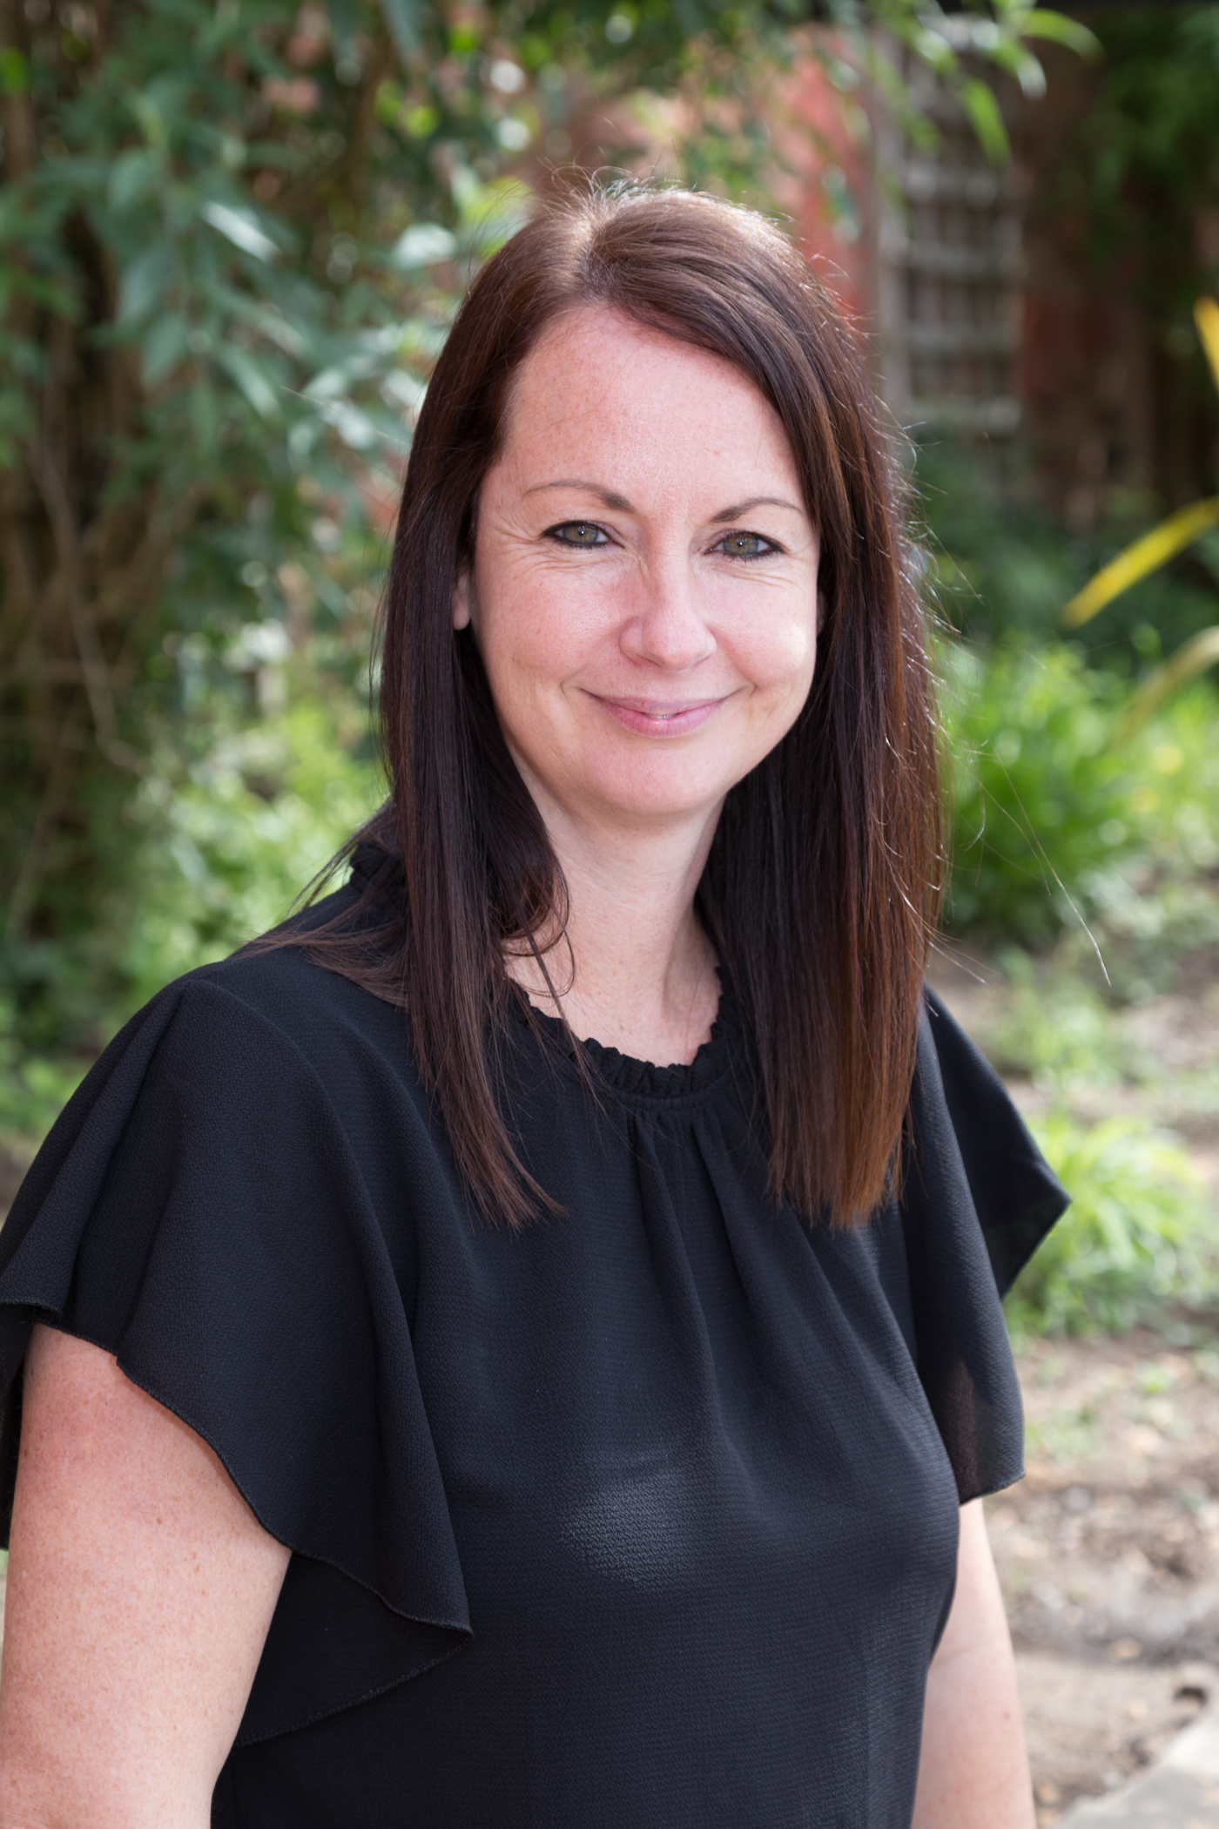
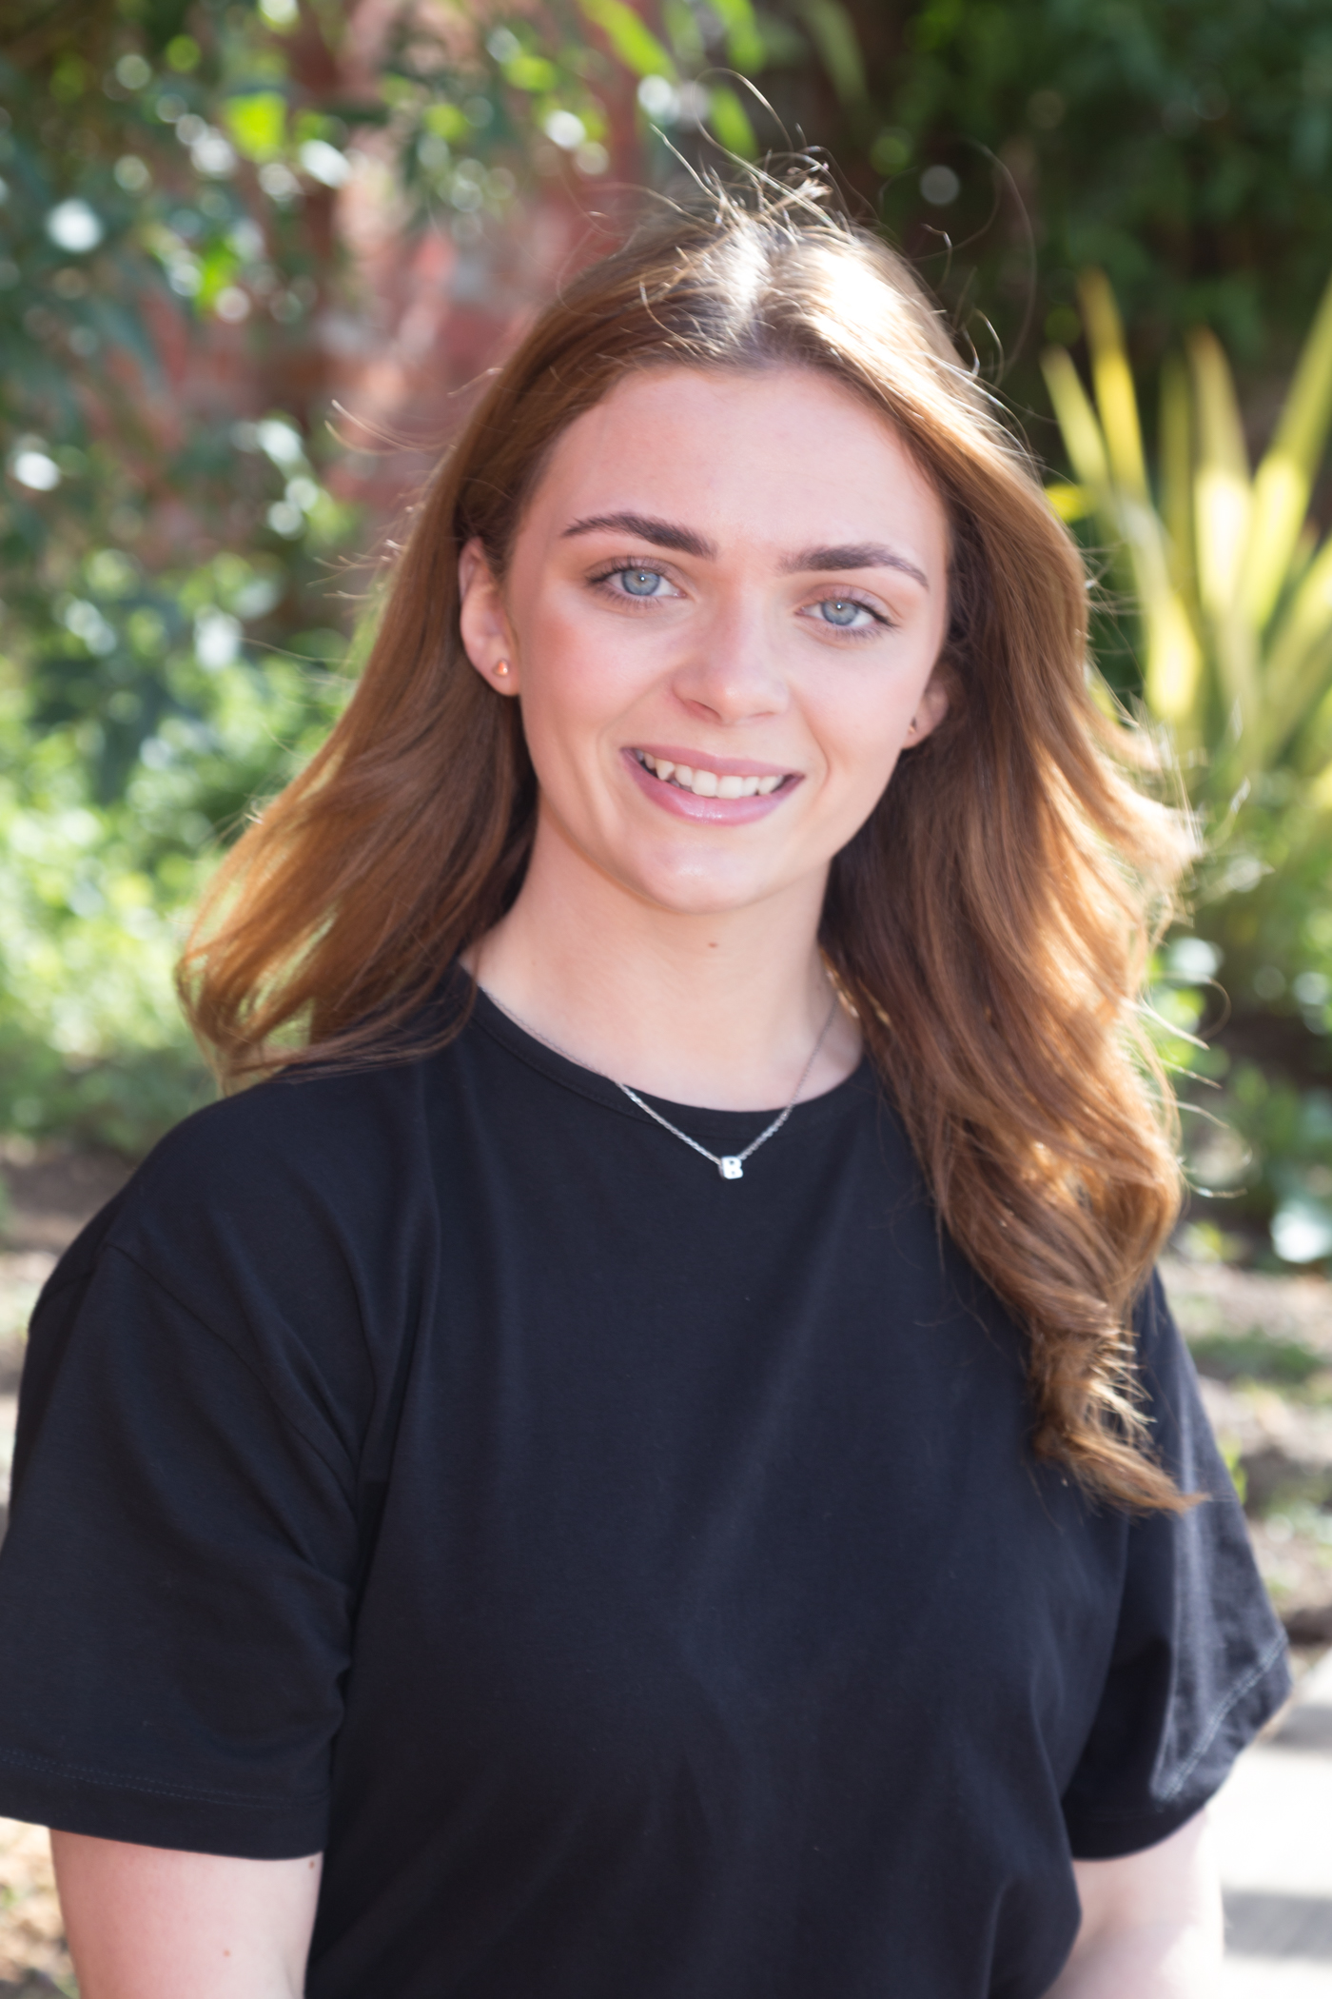
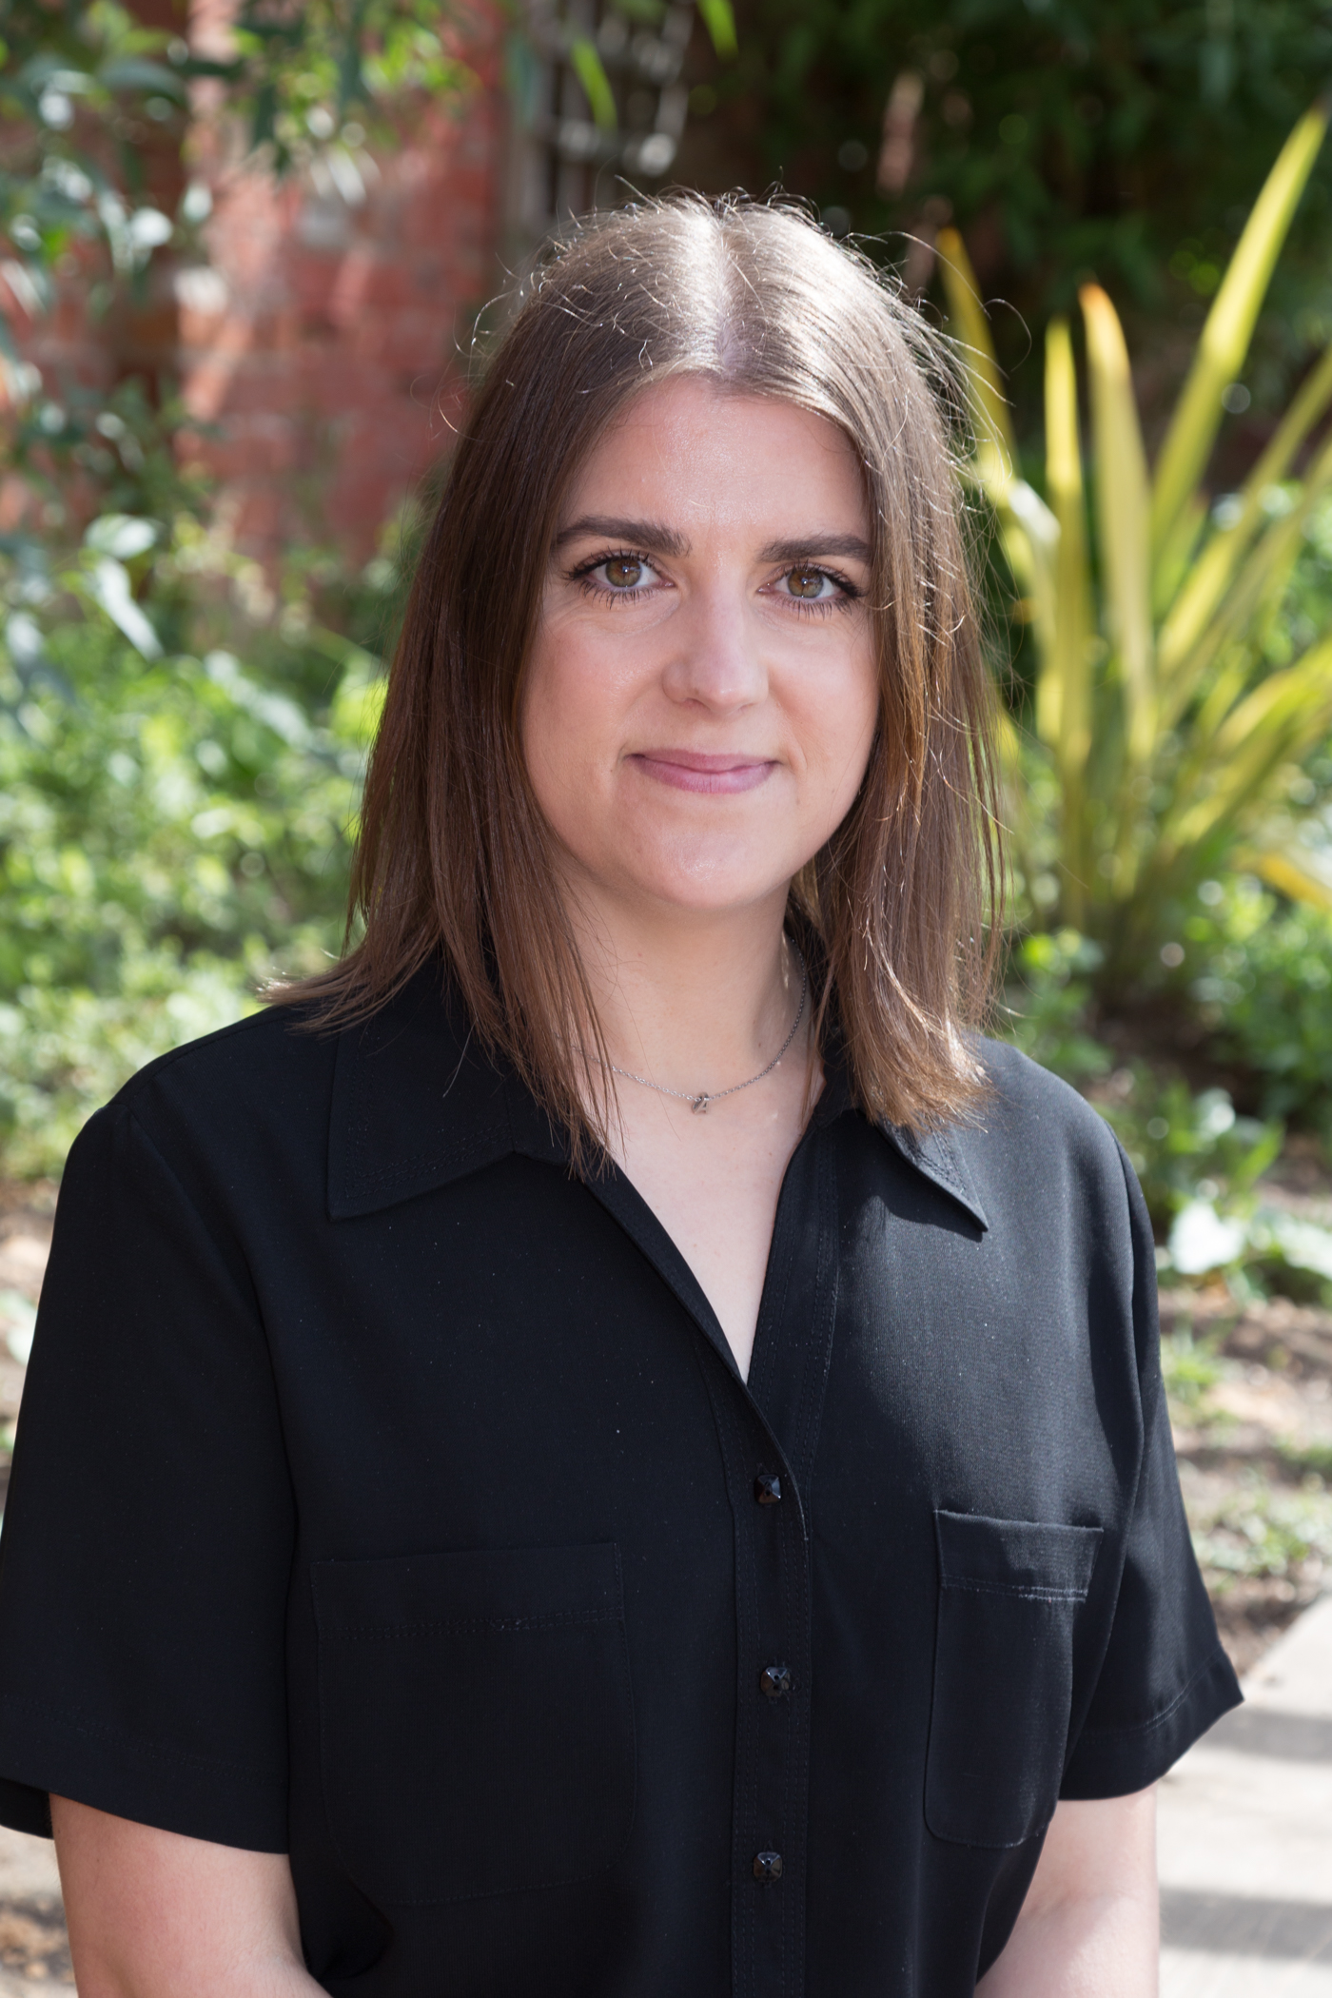
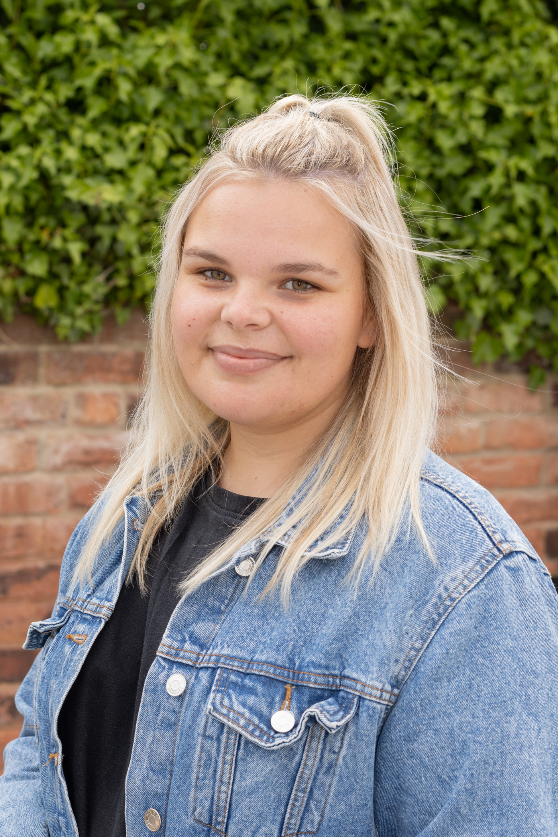
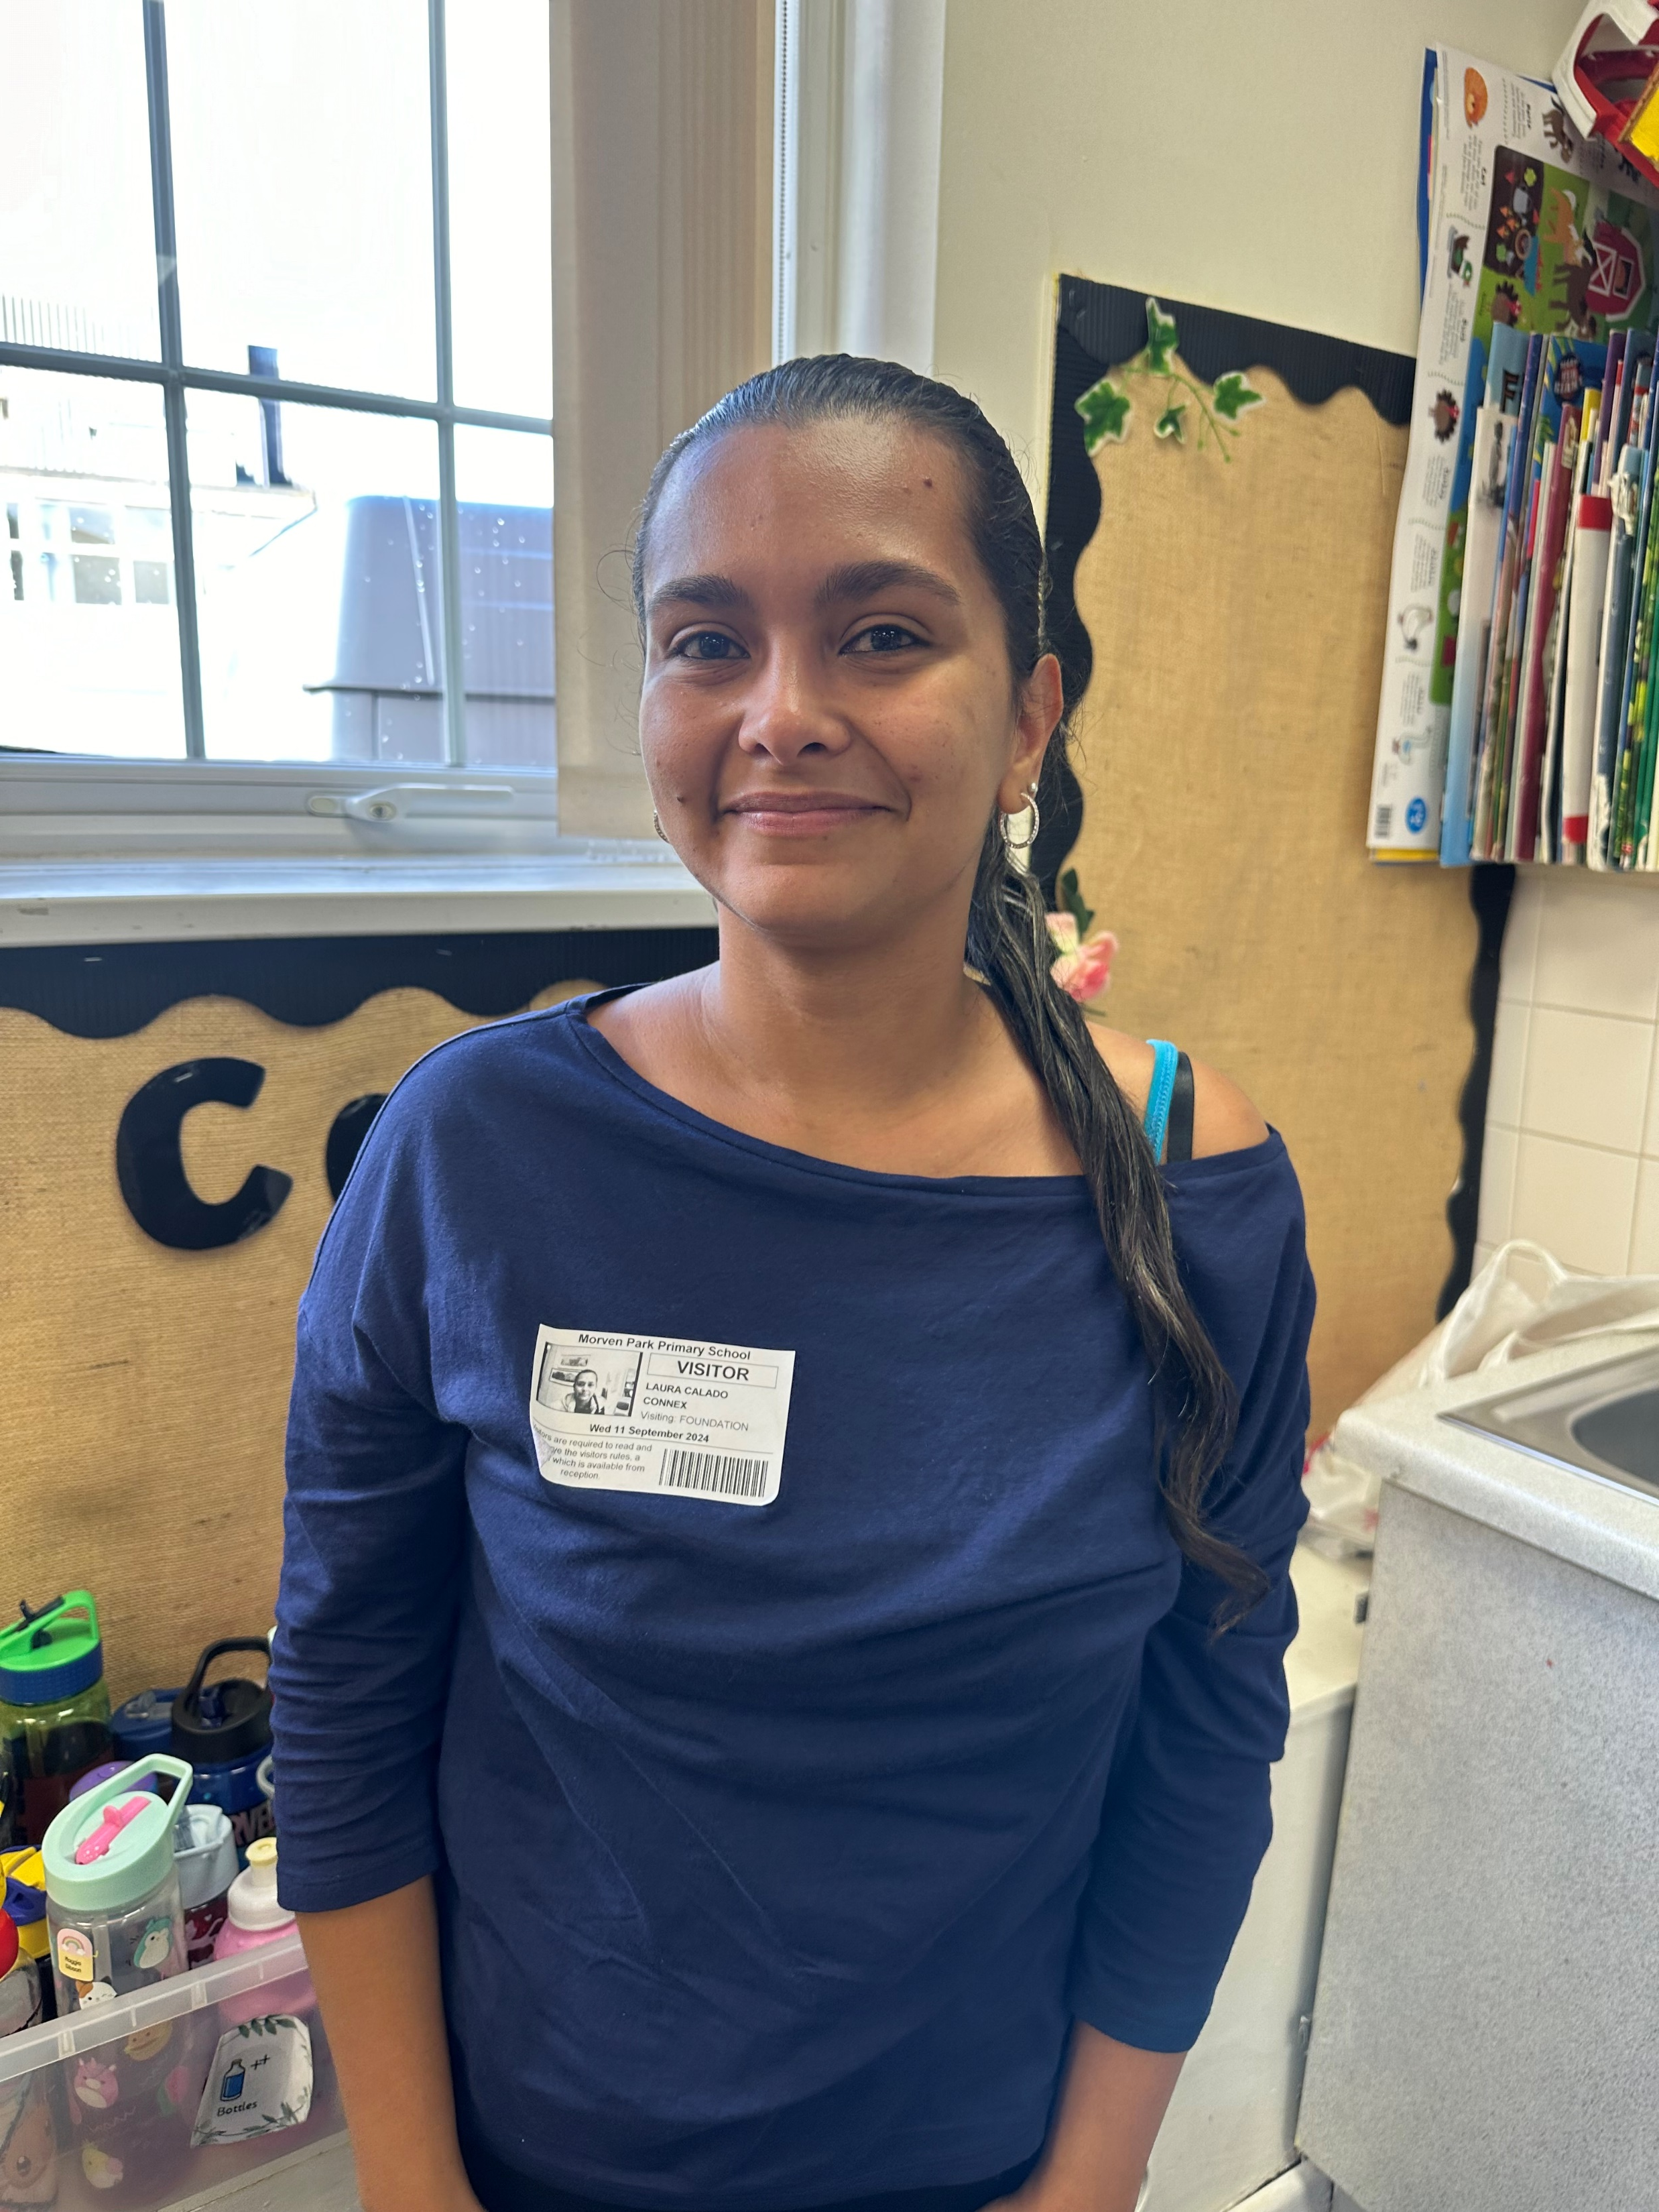
Meet the Team
Mrs Doherty
Assistant Headteacher
Foundation Stage Lead
Mrs Jackson
F2 Teacher
Miss Hannant
F2 Teaching Assistant
Miss Hastings
F2 Teaching Assistant
Miss Lester
F2 Teaching Assistant
Mrs C
F2 Teaching Assistant

Slide 3
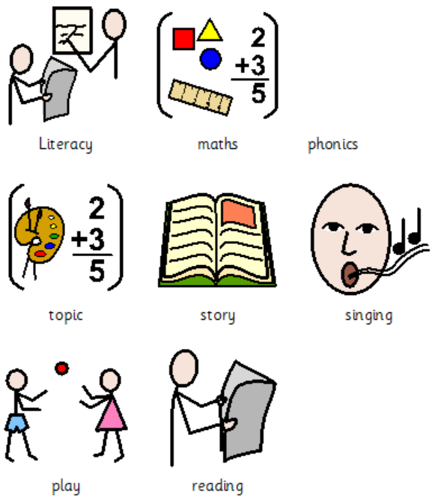


Day to Day
Monday

Slide 4
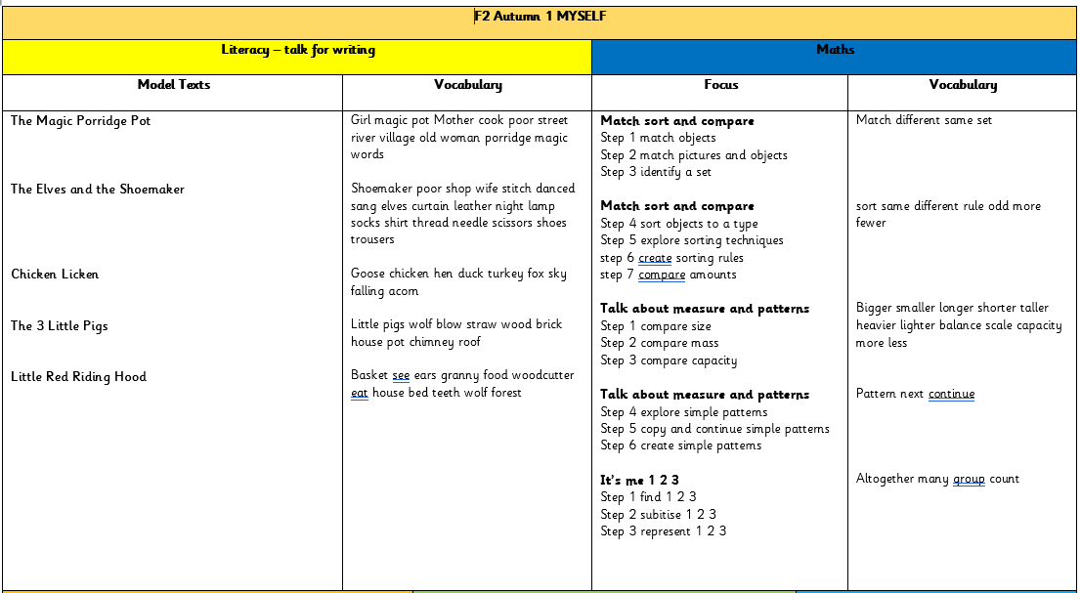

Slide 5
Our Enriched Curriculum
Autumn 1 | Autumn 2 | Spring 1 | Spring 2 | Summer 1 | Summer 2
F2 Mini first aid training | Christmas Party at Bluebell Dairy Farm World Nursery Rhyme Week Dressing up day – Pyjama Party | White Post Farm to visit school | Dressing up day – picnic British Science week | Fieldwork Fortnight | Sundown Dressing up day – beach party

Slide 6
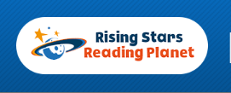
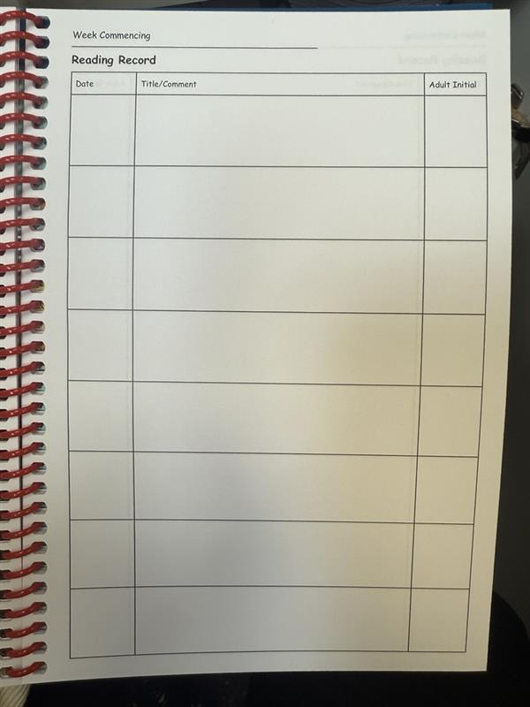
Reading
Children read at school every single day.
We read 1:1 with each child at least once a week – we record this in their reading diary.
Children need to read to you at home 3-4 times a week – this needs to be recorded in their reading diary.
Phonics videos will be sent out on Tapestry as your child’s homework each Friday. Please encourage your child to watch these to support their following week’s learning.
Children read a guided reading book each week at school.

Slide 7
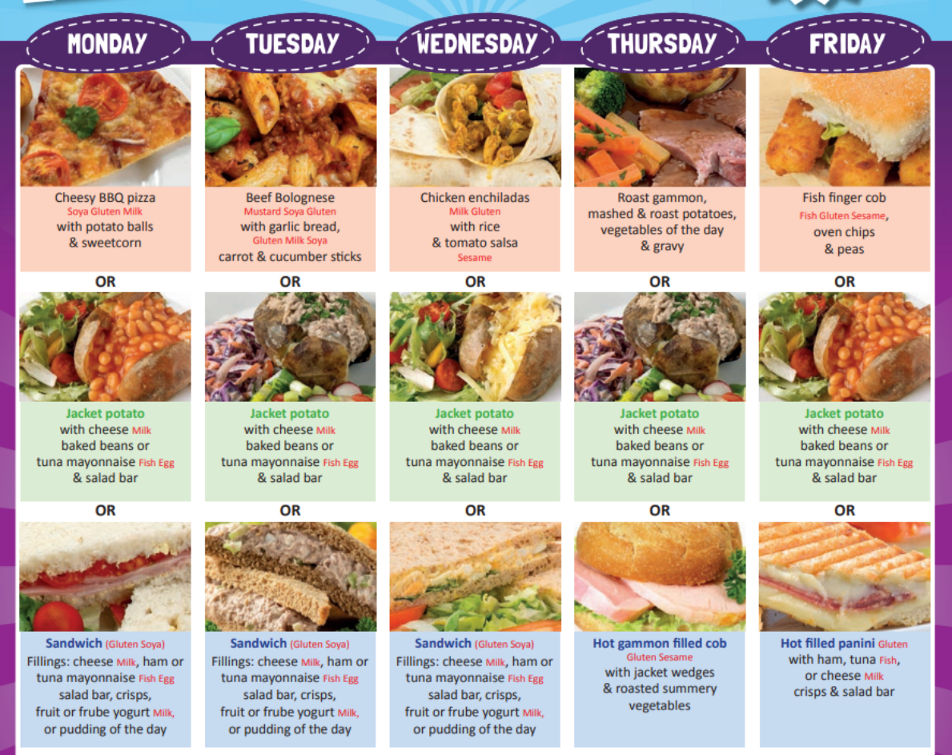
Other messages
Home time
PE plimsoles/ trainers (slip on/ velcro)
Coolmilk
Bookbags & backpacks
School dinners
Focus weeks
Jewellery – studs only
Labelling clothes

Slide 8
Any Questions?

