Slide 1

Welcome to
Year 5

Slide 2
Staff
Mr Martin (Deer)
Miss Wheater
Teaching Assistants:
Mrs Reid
Miss Marsh
Mrs Wilkinson
Mrs C
PE - Mr Geeson (Wednesday and Thursday)

Slide 3
Welcome
Daily Routines – timetables
P.E. Days (Wednesday indoor & Thursday outdoor)
Swimming starts in November
Uniform – labelled
PE Kit - labelled
Clubs and Extended Services
Challenge Monitors
Fruit Trolley – Healthy Snack
Dojo

Slide 4
Class Routines
Reading Organisers
Homework (out Friday – back Wednesday)
Good to be Green/House Points/Behaviour
Attendance/Punctuality/Holidays
Assembly time

Slide 5
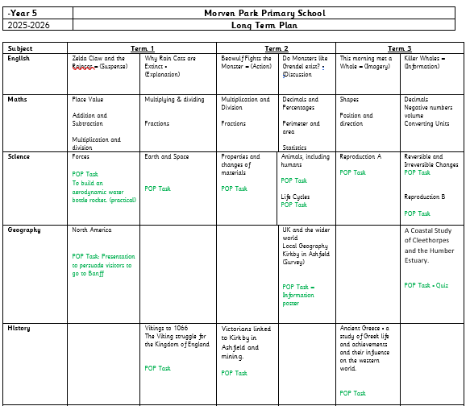
Year 5
Topics Covered:

Slide 6
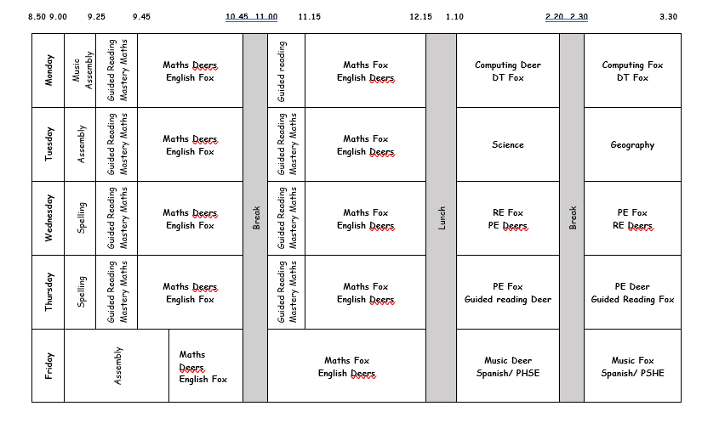
Weekly Timetable

Slide 7
Trips and Visits
Library
Southwell Workhouse and Partake Theatre – spring
Newstead Abbey and Mill Adventure – Summer

Slide 8
Around School
P.T.A.
Lost Property
The School Website
Library
Kirkby Library – Free Membership
Healthy Snacks

Slide 9
All clubs done on Dojo
Maths tutoring (during school time)
English tutoring (afterschool - invite)

Slide 10

At Home
Reading Weekly homework
3 x reads with an adult = 1 Dojo
Times tables
Spellings
Times Table Rock Stars and Reading Eggs

Slide 11
Question Time
Anything else you would like to know?

